Slide 1
Chapter 14: Applications of Linear Optimization
Business Analytics: Methods, Models,
and Desicions, 1st edition
James R. Evans

Slide 2
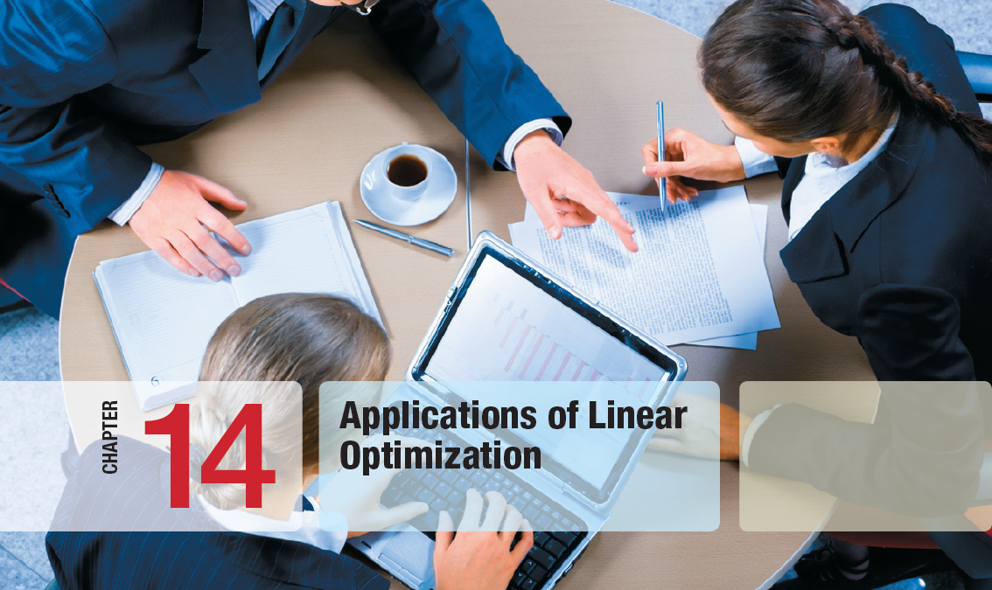

Slide 3
Chapter 14 Topics
Applications of Linear Optimization
Types of Constraints in Optimization Models
Process Selection Models
Blending Models
Portfolio Investment Models
Transportation Models
Multiperiod Production Planning Models
Multiperiod Financial Planning Models
Models with Bounded Variables
A Production/Marketing Allocation Model

Slide 4
Applications of Linear Optimization
Linear optimization models are the most ubiquitous of optimization models used in organizations today.
Applications abound in operations, finance, marketing, engineering, etc.
Building models is more of an art than a science.
Learning to build models requires logical thought facilitated by studying examples and observing their characteristics.

Slide 5
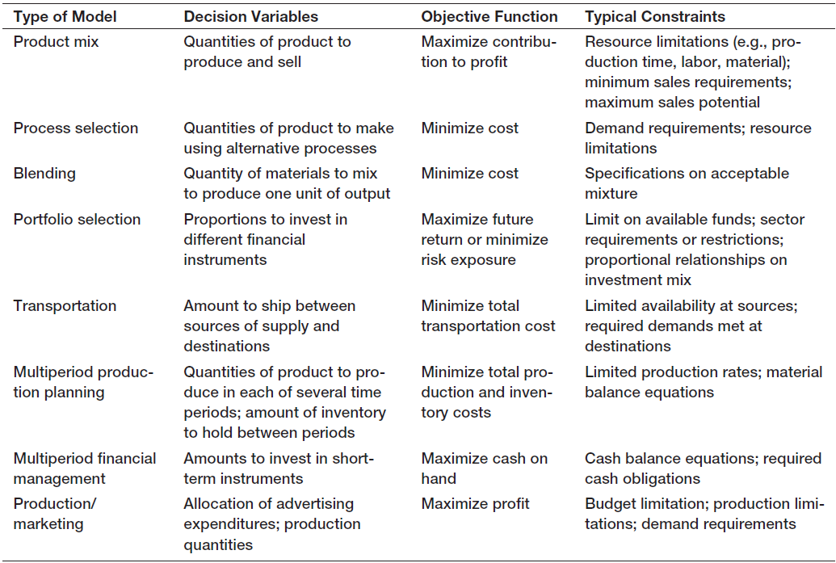
Applications of Linear Optimization
Table 14.1

Slide 6
Types of Constraints in Optimization Models
Simple Bounds
minimum or maximum values for variables
Limitations
allocation of scarce resources
Requirements
minimum levels of performance
Proportional Relationships
requirements for mixing or blending
Balance Constraints
input equals output

Slide 7
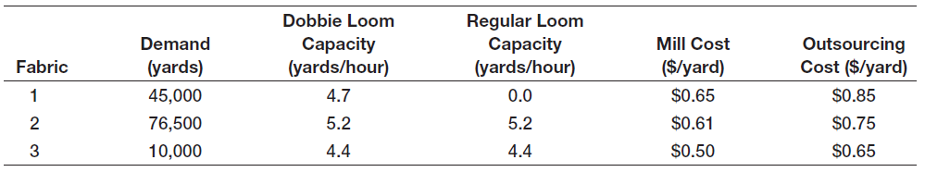
Process Selection Models
Example 14.1 Camm Textiles
A mill that operates on a 24/7 basis produces three types of fabric on a make-to-order basis.
The key decision is which type of loom to use for each fabric type over the next 13 weeks.
The mill has 3 dobbie looms and 15 regular looms.
If demand cannot be met, the fabric is outsourced.
Table 14.2

Slide 8
Process Selection Models
Example 14.1 (continued) Camm Textiles
D_{i} = yards fabric i to produce on dobbie loom
R_{i} = yards fabric i to produce on regular loom
P_{i} = yards fabric i to outsource
Objective
Minimize total cost of milling and outsourcing
Constraints
Limitations - loom capacities
Requirements - meet demand
Nonnegativity

Slide 9
Process Selection Models
Example 14.1 (continued) Camm Textiles
Loom capacity limitation constraints
Convert yards/hour into hours/yard.
For fabric 1 on the dobbie loom
hours/yard = 1/(4.7 yards/hour) = 0.213 hours/yard
For the RHS capacity of the dobbie loom
(24 hours/day)(7 days/week)(13 weeks)(3 looms)
= 6,552 hours/loom
Table 14.2

Slide 10
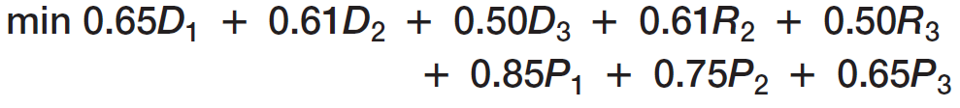
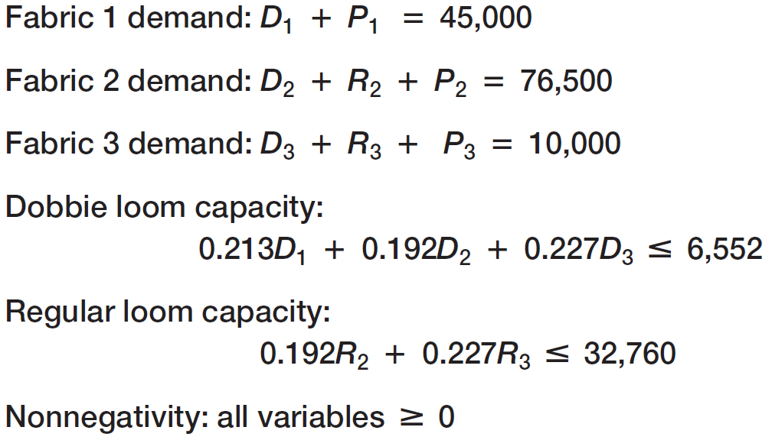
Process Selection Models
Example 14.1 (continued) Camm Textiles

Slide 11
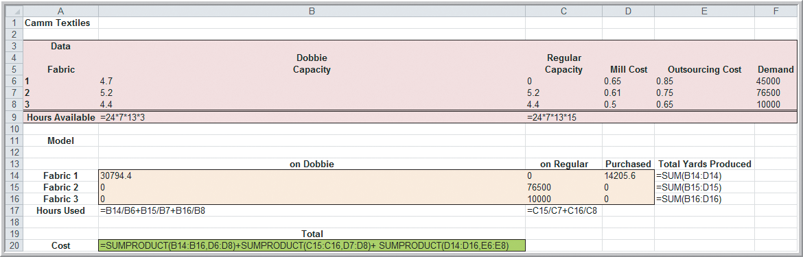
Process Selection Models
Spreadsheet Design and Solver Reports
Camm Textiles LP model
Pink cells are model parameters.
Beige cells are solution values of the decision variables.
Green cell is the optimal value of the objective.
Figure 14.1b

Slide 12
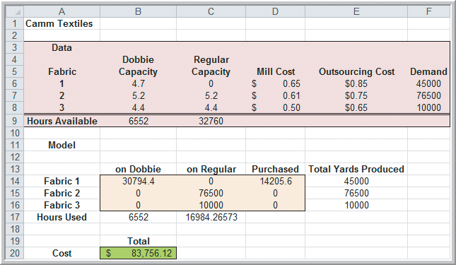
Process Selection Models
Spreadsheet Design and Solver Reports
Camm Textiles LP model
Figure 14.1a

Slide 13
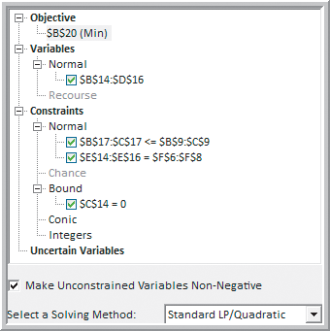
Process Selection Models
Spreadsheet Design and Solver Reports
Risk Solver Parameter
dialog for Camm Textiles
Set a bound of C14 = 0 since we included C14 in the B14:D16 variables but the regular loom cannot produce fabric 1.
Figure 14.2

Slide 14
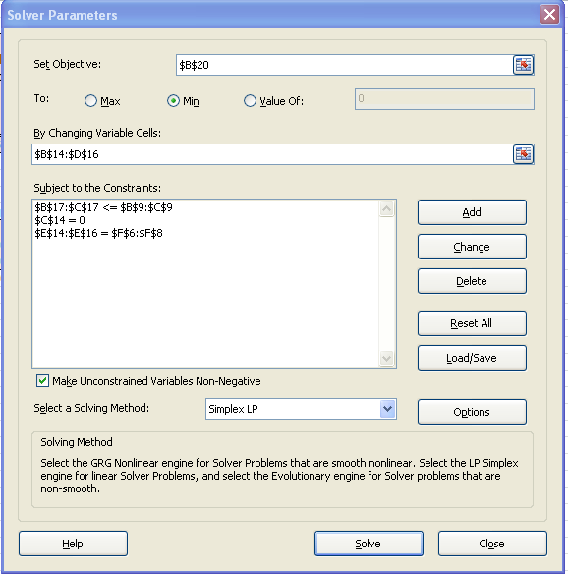
Process Selection Models
Spreadsheet Design and Solver Reports
Regular Solver Parameter
dialog for Camm Textiles
Specify a constraint C14 = 0 since the regular loom cannot produce fabric 1.

Slide 15
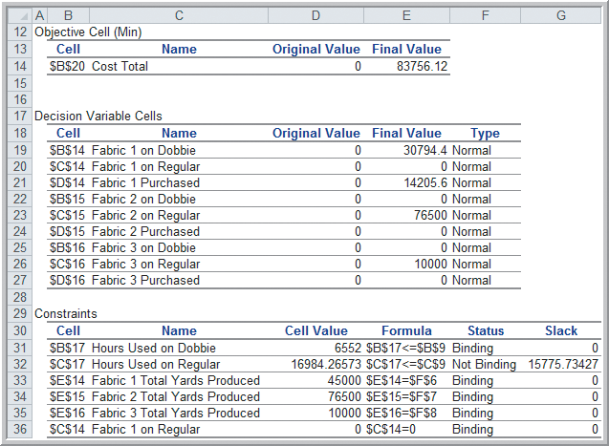
Process Selection Models
Example 14.2 Interpreting Solver Reports for the
Camm Textiles Problem
Solver Answer Report
Profit = $87,756.12
D₁ = 30794.4 yards
P₁ = 14205.6 yards
R₂ = 76500.0 yards
R₃ = 10000.0 yards
The regular loom
has excess capacity.
Figure 14.3

Slide 16
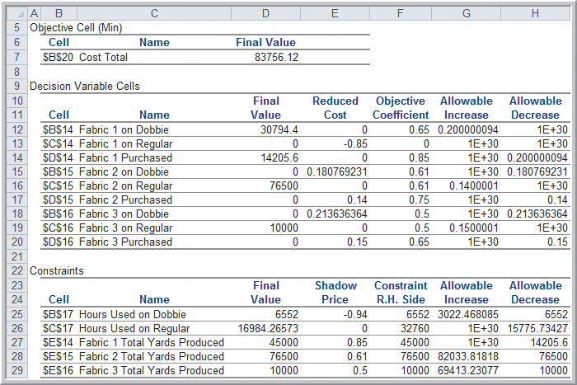
Process Selection Models
Example 14.2 (continued) Interpreting Solver Reports for the Camm Textiles Problem
Solver Sensitivity Report
The outsourcing cost of fabric 2 needs to decrease by $0.14 to become economical.
Producing an extra yard of fabric 1 costs $0.85 (its outsourcing cost).
Figure 14.4

Slide 17
Blending Models
Example 14.3 BG Seed Company
BG Seed Company mixes food products for a variety of birdseed mixes.
A new birdseed product is being developed and it can use 8 ingredients.
Nutritional requirements specify that the mixture contain at least 13% protein, at least 15% fat, and no more than 14% fiber.
BG’s objective is to determine the minimum cost mixture that meets nutritional requirements.

Slide 18
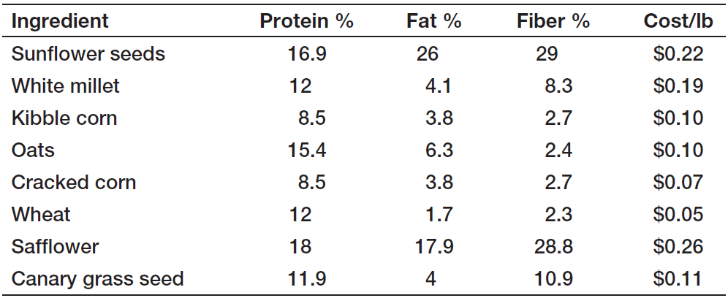
Blending Models
Example 14.3 (continued) BG Seed Company
Define the 8 decision variables as:
X_{i} = pounds of ingredient i in 1 pound of mix
Table 14.3

Slide 19
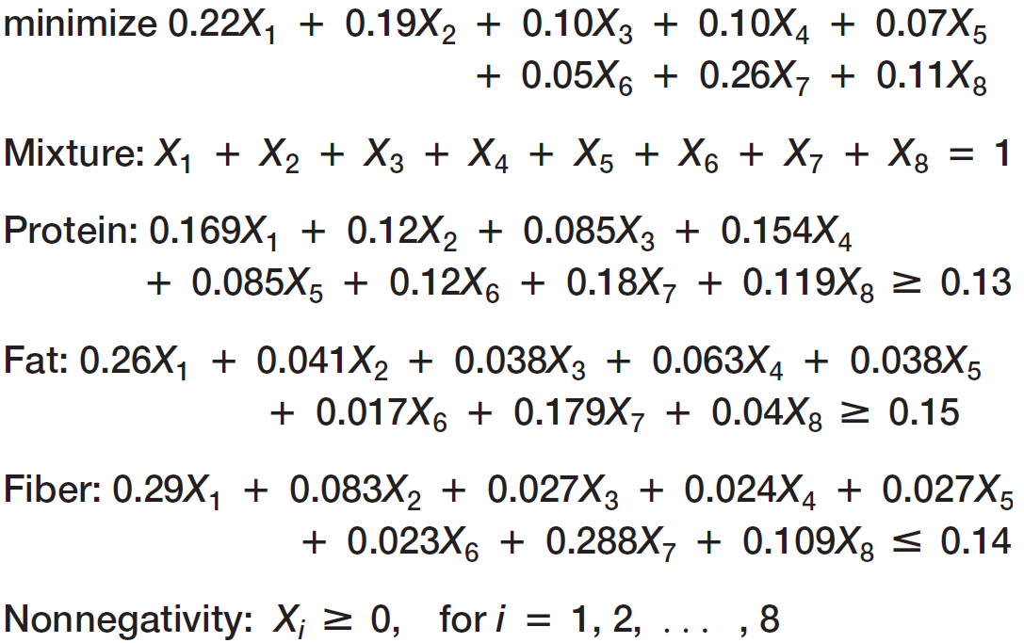
Blending Models
Example 14.3 (continued) BG Seed Company

Slide 20
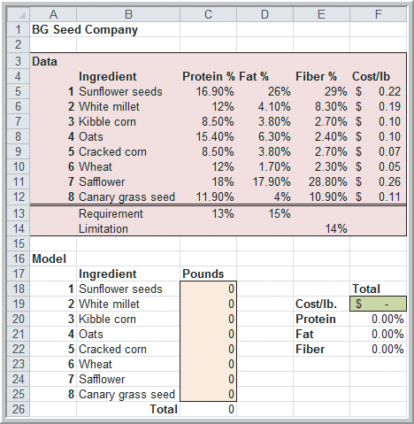
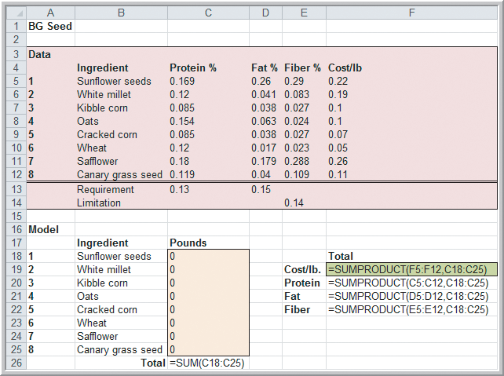
Blending Models
Dealing With Infeasibiltiy
BG Seed LP formulation in Excel
Figure 14.5

Slide 21
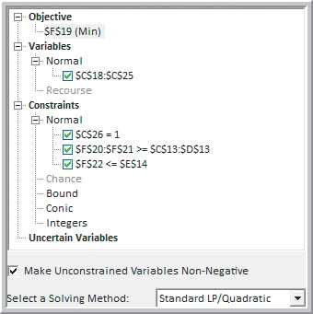
Blending Models
Dealing With Infeasibility
Risk Solver Parameter dialog for BG Seed Company
Figure 14.6

Slide 22
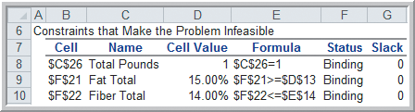
Blending Models
Dealing With Infeasibility
Solver Feasibility Report for BG Seed Company
Figure 14.7
A conflict exists in trying to meet both fat and fiber constraints.
Only sunflower seeds and safflower contain enough fat but they also have a lot of fiber.

Slide 23
Blending Models
Dealing With Infeasibility
BG Seed Company
Table 14.3

Slide 24
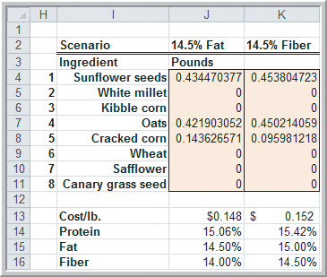
Blending Models
Dealing With Infeasibility
BG Seed Company – Two What-If Scenarios
1st Scenario:
Fat requirement is lowered from 15% to 14.5%.
2nd Scenario:
Fiber limitation is raised from 14% to 14.5%.
Optimal Cost per pound:
$0.148 if fat requirement lowered
$0.152 if fiber limitation raised
Figure 14.8

Slide 25
Portfolio Investment Models
Example 14.4 Innis Investments
Innis Investments manages 6 mutual funds.
A client wants to invest a $500,000 inheritance.
The objective is to minimize risk.
Constraints:
Invest no more than $200,000 in any one fund.
Invest at least $50,000 each in the multinational and balanced funds.
Invest at least 40% combined in the income equity and balanced funds.
Achieve an average return of at least 5%.

Slide 26
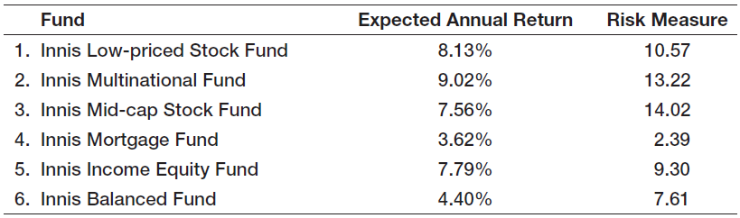
Portfolio Investment Models
Example 14.4 (continued) Innis Investments
Define the 6 decision variables as:
X_{i} = dollar amount invested in fund i
Table 14.4

Slide 27
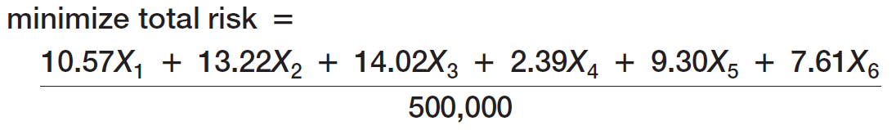
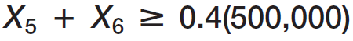
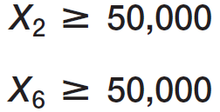
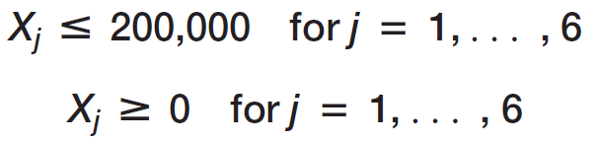
Portfolio Investment Models
Example 14.4 (continued) Innis Investments

Slide 28
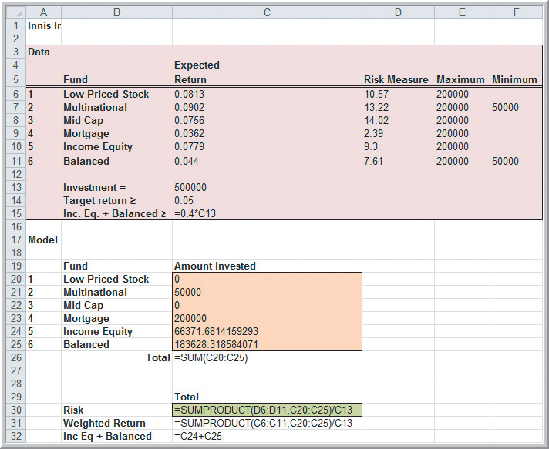
Portfolio Investment Models
Innis Investments – Excel worksheet formulas
Figure 14.9b

Slide 29
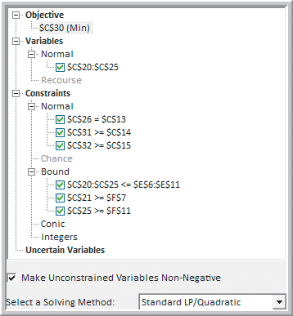
Portfolio Investment Models
Risk Solver Parameter dialog for Innis Investments
Figure 14.10

Slide 30
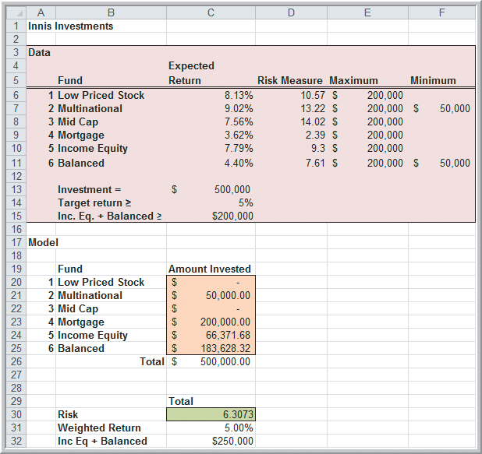
Portfolio Investment Models
Innis Investments – Excel worksheet solution
Risk = 6.3073
X₁ = 0
X₂ = $50,000
X₃ = 0
X₄ = $200,000
X₅ = $66,371
X₆ = $183,628
Figure 14.9a

Slide 31
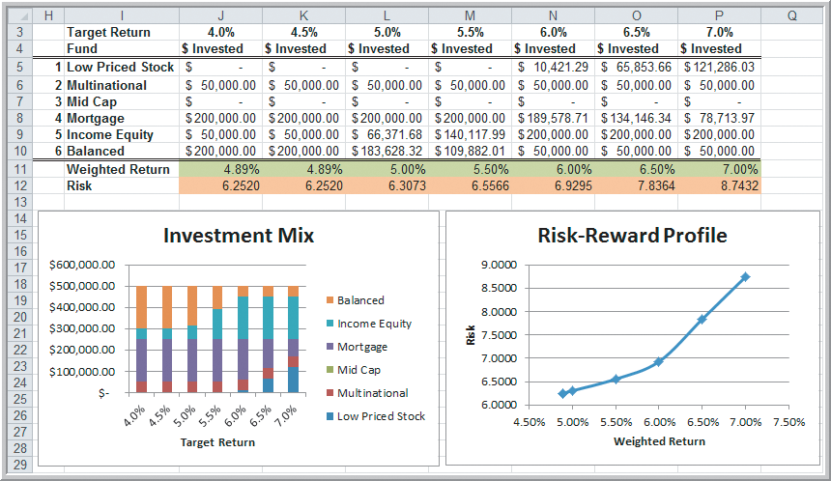
Portfolio Investment Models
Example 14.5 Risk Versus Reward
Innis Investment Solutions for varying target returns
As target return increases, so does risk.
Figure 14.11

Slide 32
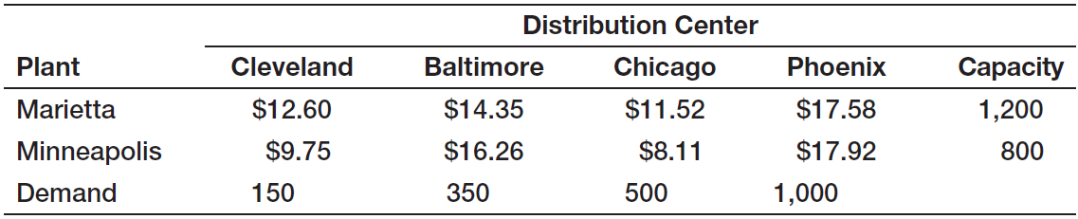
Transportation Models
Example 14.6 General Appliance Corporation
GAC produces refrigerants at 2 plants.
GAC ships refrigerants to 5 distribution centers.
The objective is to minimize the total cost of shipping between plants and distribution centers.
Define the 10 decision variables as: X_{ij} = amount shipped from plant i to distribution center j
Table 14.5

Slide 33
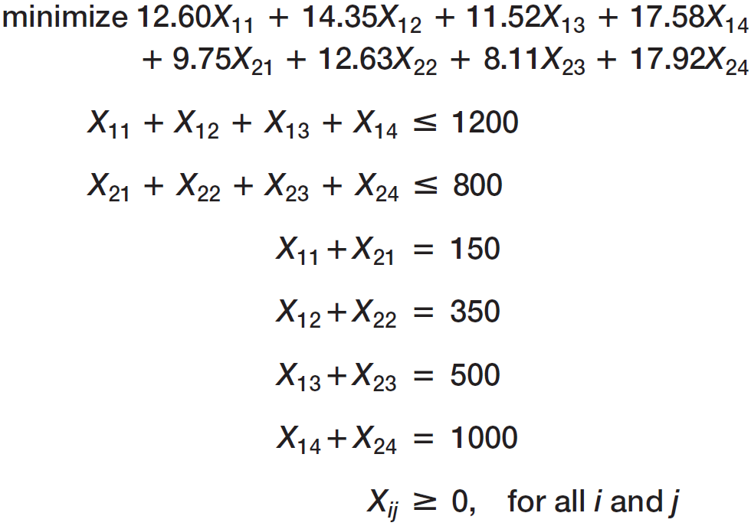
Transportation Models
Example 14.6 (continued)
General Appliance Corporation

Slide 34
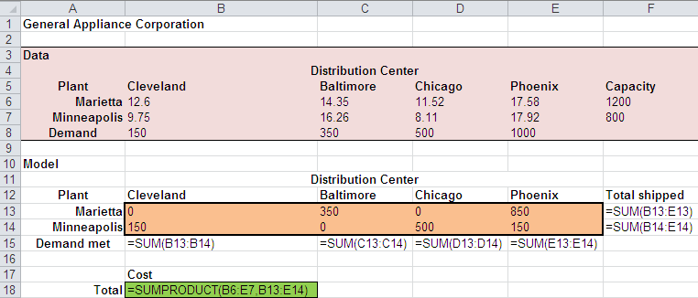
Transportation Models
Example 14.6 (continued)
General Appliance Corporation
Excel worksheet formulas
From Figure 14.12

Slide 35
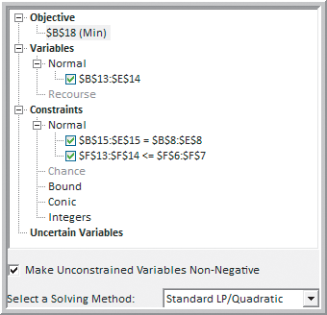
Transportation Models
Example 14.6 (continued) General Appliance Corporation
Risk Solver
Parameter dialog
Figure 14.13

Slide 36
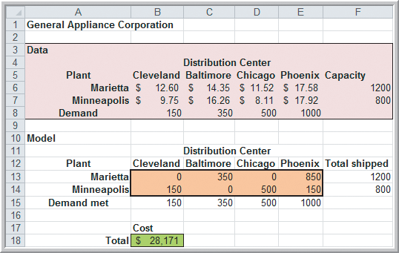
Transportation Models
Example 14.6 (continued)
General Appliance Corporation
Excel worksheet solution
Cost = $28,171
X₁₁ = 0
X₁₂ = 350
X₁₃ = 0
X₁₄ = 850
X₂₁ = 150
X₂₂ = 0
X₂₃ = 500
X₂₄ = 150
Figure 14.12

Slide 37
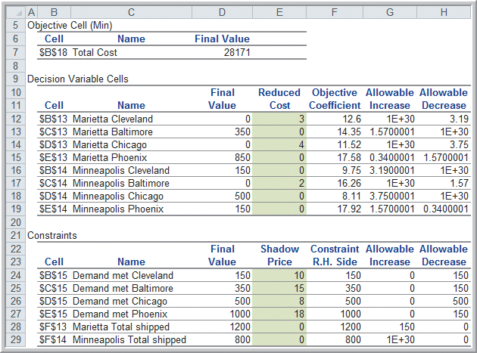
Transportation Models
Example 14.7 Interpreting Sensitivity Information for the GAC Model
Original version of Sensitivity Report
Reduced costs and shadow prices are formatted as whole numbers.
Reformat those cells to see decimal values.
Figure 14.14

Slide 38
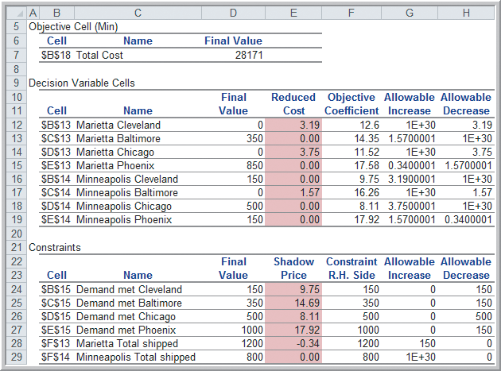
Transportation Models
Example 14.7 (continued) Interpreting Sensitivity Information for the GAC Model
Accurate Sensitivity Report
Reduced cost are zero for variables that are positive.
Allowable increase in all the demand constraints is zero.
Shadow prices reflect the cost savings for a unit decrease in demand.
The solution is degenerate because the number of positive variables is less than the number of constraints (5 < 6).
Figure 14.15

Slide 39
Multiperiod Production Planning Models
Example 14.8 K&L Designs
K&L Designs makes hand-painted jewelry boxes.
Forecasted sales are 150 in autumn, 400 in winter, and 50 in spring.
Unpainted boxes cost $20 and each box takes 2 hours to complete.
The cost of capital is 6% per quarter.
Holding cost per item = 0.06(20) = $1.20/quarter
$/hour labor rates are 5.5, 7, and 6.25 during autumn, winter, and spring, respectively.
Objective: Minimize the combined cost of production and inventory holding costs.

Slide 40
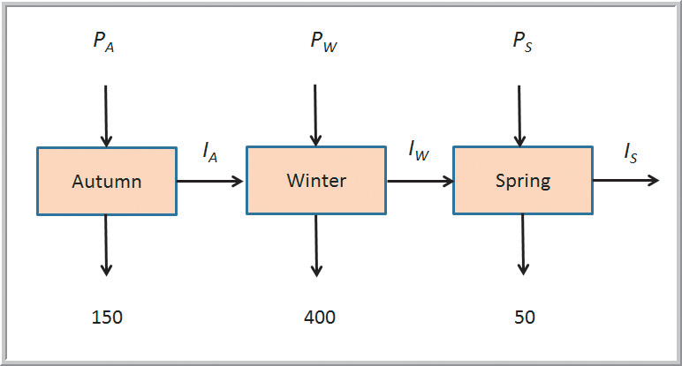
Multiperiod Production Planning Models
Example 14.8 (continued) K&L Designs
P_{i} = amount to produce in season i
I_{j} = inventory at the end of season j
Figure 14.16

Slide 41
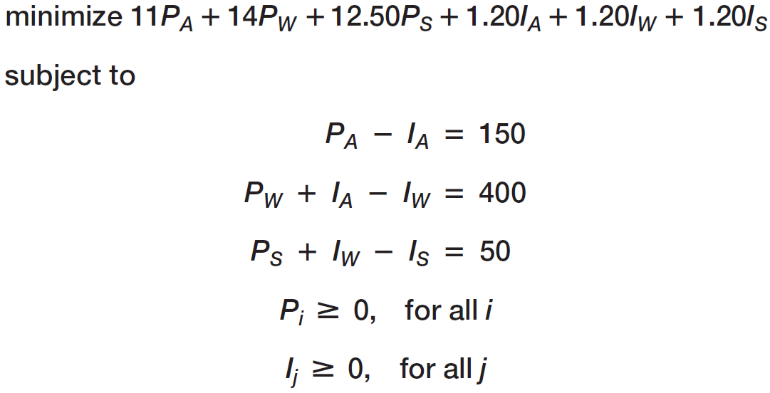
Multiperiod Production Planning Models
Example 14.8 (continued) K&L Designs
Objective function coefficient for P_{S} variable:
($6.25/hour)(2 hours/box) = $12.50
Box costs need not be subtracted because they are constant.

Slide 42
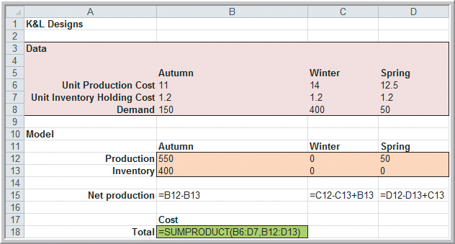
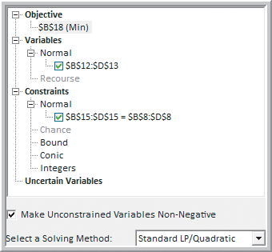
Multiperiod Production Planning Models
Example 14.8 (continued) K&L Designs
Solving the LP using Risk Solver
Figure 14.17b
Figure 14.18

Slide 43
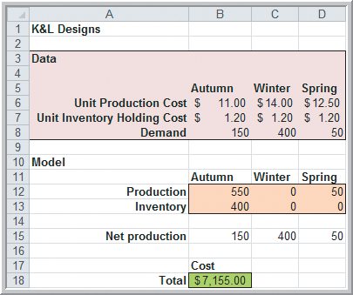
Multiperiod Production Planning Models
Example 14.8 (continued)
K&L Designs
Produce:
550 units in autumn
0 units in winter
50 units in spring
Figure 14.17

Slide 44
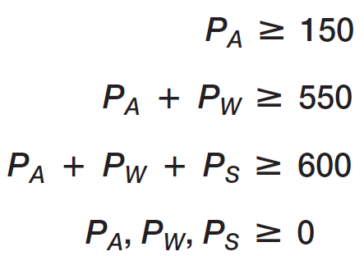
Multiperiod Production Planning Models
Example 14.9 An Alternative Optimization Model for K&L Designs
The constraints simply ensure demand is met. So we can eliminate the I_{j} decision variables.
Figure 14.19

Slide 45
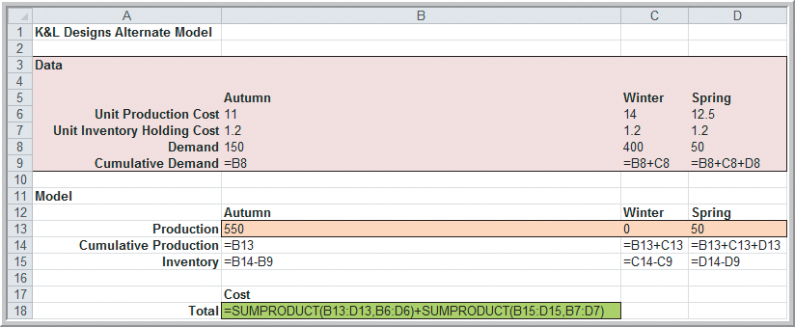
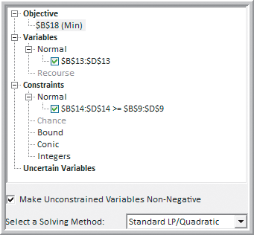
Multiperiod Production Planning Models
Example 14.9 (continued) An Alternative Optimization Model for K&L Designs
Solving the LP using Risk Solver
Figure 14.19b
Figure 14.20

Slide 46
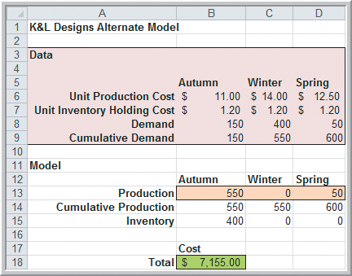
Multiperiod Production Planning Models
Example 14.9 (continued)
An Alternative Optimization
Model for K&L Designs
Again, produce:
550 units in autumn
0 units in winter
50 units in spring
Figure 14.19

Slide 47
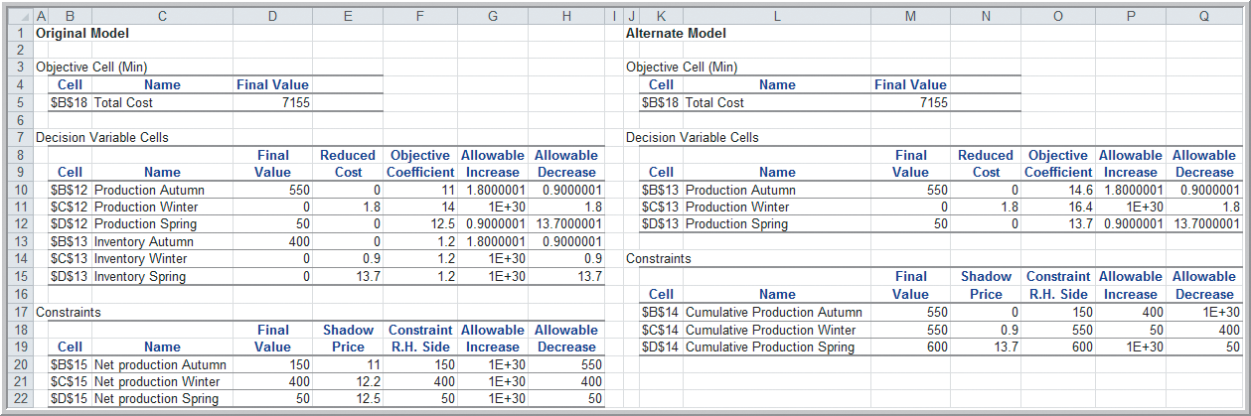
Multiperiod Production Planning Models
Example 14.9 (continued) An Alternative Optimization Model for K&L Designs
We obtain the same results using the “streamlined” alternate model.
Figure 14.21

Slide 48
Multiperiod Financial Planning Models
Example 14.10 D.A. Branch & Sons
The company’s financial manager needs to insure that funds are available to pay expenses yet needs to maximize investment income.
Three short-term investments are being considered:
1-month CD paying 0.25%
3-month CD paying 1.00%
6-month CD paying 2.30%
A cash balance of $10,000 must be maintained
Currently the cash balance is $200,000.

Slide 49
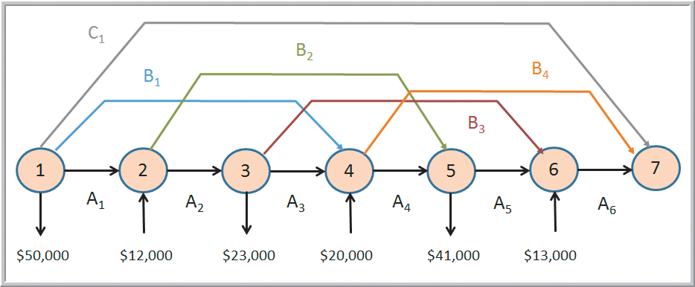
Multiperiod Financial Planning Models
Example 14.10 (continued) D.A. Branch & Sons
Net expenditures for the next 6 months
Figure 14.22
A_{i} = amount ($) to invest in a 1-month CD at the start of month i
B_{i} = amount ($) to invest in a 3-month CD at the start of month i
C_{i} = amount ($) to invest in a 6-month CD at the start of month i

Slide 50
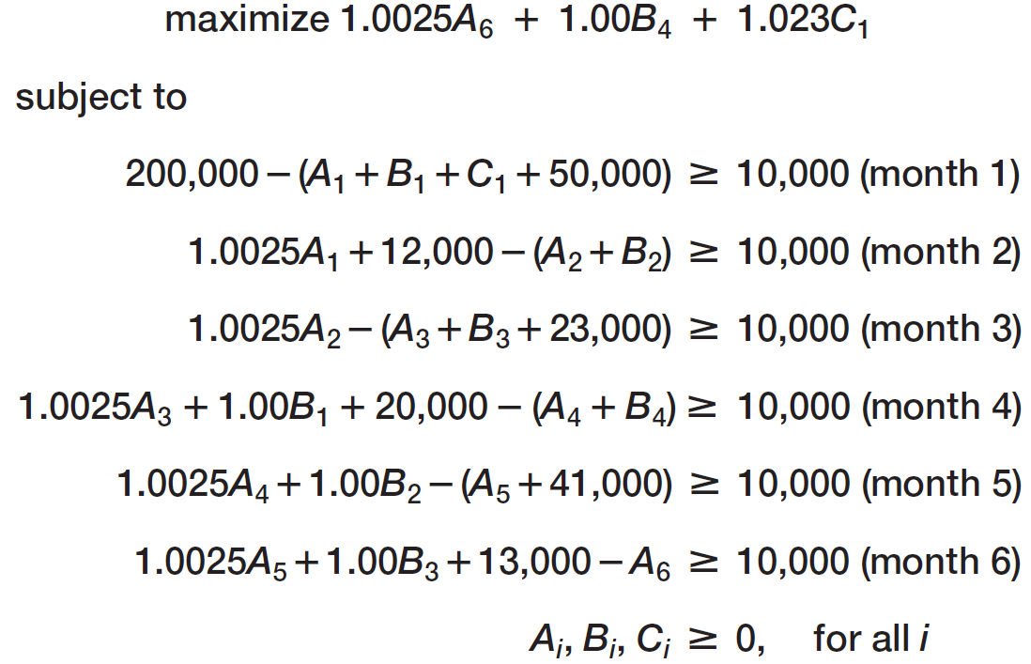
Multiperiod Financial Planning Models
Example 14.10 (continued) D.A. Branch & Sons

Slide 51
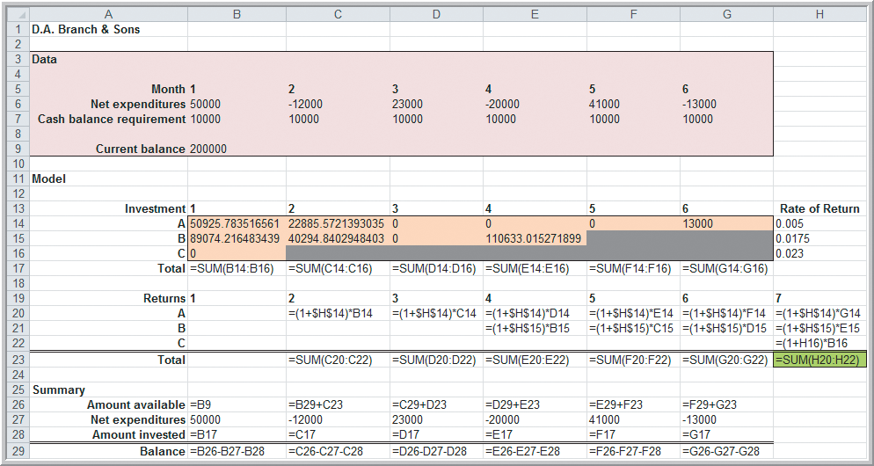
Multiperiod Financial Planning Models
Example 14.10 (continued) D.A. Branch & Sons
Figure 14.23b

Slide 52
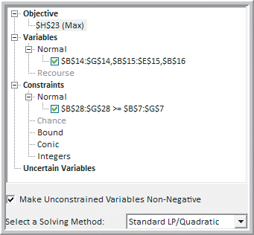
Multiperiod Financial Planning Models
Example 14.10 (continued) D.A. Branch & Sons
Solving the LP using Risk Solver
Figure 14.23b
Figure 14.24

Slide 53
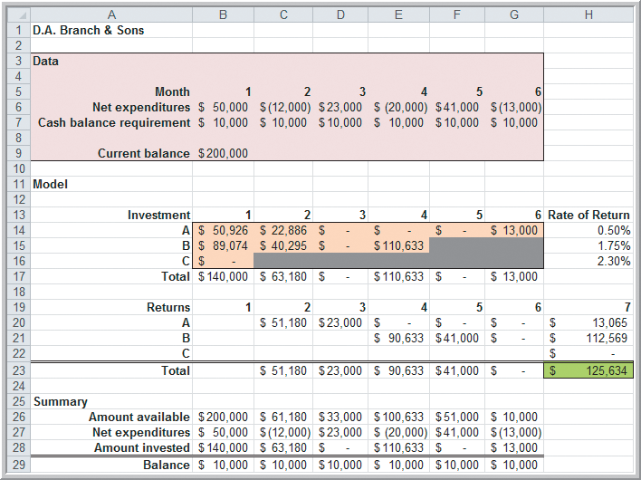
Multiperiod Financial Planning Models
Example 14.10 (continued) D.A. Branch & Sons
Total return = $125,634
Invest in a 1-month CD at the end of months 1, 2, and 6.
Invest in a 3-month CD at the end of months 1, 2, and 4.
Figure 14.23a

Slide 54

Multiperiod Financial Planning Models
Analytics in Practice:
Linear Optimization in
Bank Financial Planning
Carolina Central Bank uses linear optimization to coordinate activities of its banking business.
A 1-year single-period model containing 66 asset and 32 liability and equity categories is used.
Even though the model ignores many time-related linkages, it is a model that is of appropriate detail for senior management use.

Slide 55
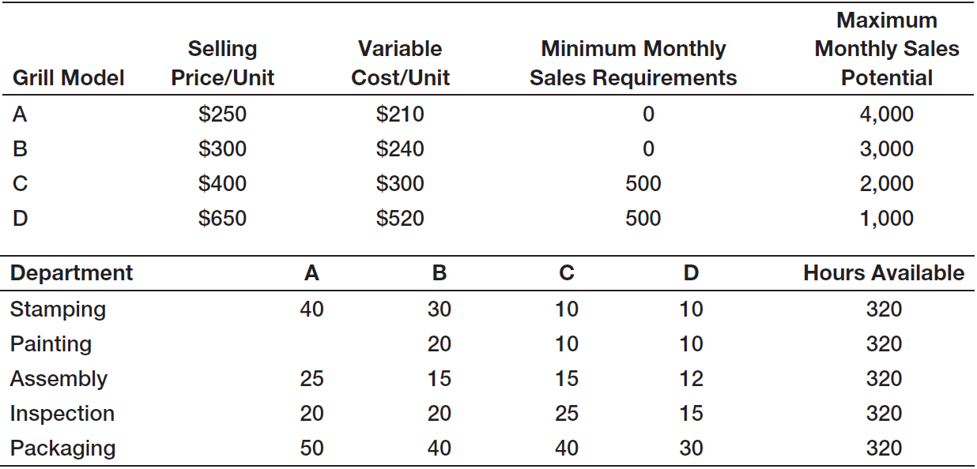
Models with Bounded Variables
Example 14.11 J&M Manufacturing
J&M Manufacturing makes 4 models of gas grills
Production managers want to determine how many grills to produce in order to maximize profit.
Table 14.6

Slide 56





Models with Bounded Variables
Example 14.11 (continued) J&M Manufacturing

Slide 57


Models with Bounded Variables
Example 14.11 (continued) J&M Manufacturing
Solving the LP using Risk Solver
Figure 14.26
Figure 14.25b

Slide 58

Models with Bounded Variables
Example 14.11 (continued) J&M Manufacturing
Total profit = $407,857
Optimal number of gas grills to produce:
A = 3857
B = 0
C =1236
D = 0
Figure 14.25a

Slide 59

Models with Bounded Variables
Example 14.11 (continued) J&M Manufacturing
Solver Answer Report
Binding constraints Upper bound on sales
of grill D
Lower bound on sales
of grill B
Figure 14.27

Slide 60

Models with Bounded Variables
Example 14.11 (continued) J&M Manufacturing
Solver Sensitivity Report
The 8 boundary constraints do not appear in this report.
The reduced cost of a bounded variable is equal to the shadow price of its boundary constraint.
Figure 14.28

Slide 61
Models with Bounded Variables
Example 14.12 Using Auxiliary Variable Cells
(for the J&M Manufacturing model)
Auxiliary variables allow easier interpretation of shadow prices for bounded variables.
If we add auxiliary variables to the Excel model formulation, then Solver’s sensitivity report will:
- show the boundary constraints
- give us information about allowable increases
and decreases in the RHS values.

Slide 62


Models with Bounded Variables
Example 14.12 (continued)
Using Auxiliary Variable Cells
The 4 auxiliary variables in row 29 are simply set equal to the 4 decision variables in row 25.
Figure 14.29

Slide 63

Models with Bounded Variables
Example 14.12 (continued)
Using Auxiliary Variable Cells
Solving the LP using Risk Solver
Add the 8 boundary constraints to the model.
Figure 14.30

Slide 64

Models with Bounded Variables
Example 14.12 (continued) Using Auxiliary Variables
Solver Sensitivity Report
The 8 boundary constraints now appear in the report.
Auxiliary variable constraints correspond to the boundary constraints.
Figure 14.31

Slide 65
A Production/Marketing Model
Example 14.13 Walker Wines
Walker Wines buys grapes from local growers and blends the pressings to make two types of wine (Shiraz and Merlot).
Grape costs are $1.60 per bottle Shiraz and $1.40 per bottle Merlot.
Their contract requires between 40% and 70% of their wine to be Shiraz.
Predicted demand for Shiraz is 1000 bottles but increases by 5 bottles for each dollar spent on advertising.

Slide 66
A Production/Marketing Model
Example 14.13 (continued) Walker Wines
Demand for Merlot is 2000 bottles but increases by 8 for each dollar spent on advertising.
Selling prices per bottle are $6.25 for Shiraz and $5.25 for Merlot.
Walker Wines has $50,000 available to purchase grapes and advertising.
Wine production should not exceed demand.
The objective is to maximize profit.

Slide 67






A Production/Marketing Model
Example 14.13 (continued) Walker Wines

Slide 68


A Production/Marketing Model
Example 14.13 (continued) Walker Wines
Solving the LP using Risk Solver
Figure 14.32b
Figure 14.33

Slide 69

A Production/Marketing Model
Example 14.13 (continued) Walker Wines
Total profit = $124,776
Optimal number of bottles to produce:
Shiraz = 20,562
Merlot = 8,812
Optimal advertising:
Shiraz = $3912
Merlot = $851
Figure 14.32a

Slide 70

A Production/Marketing Model
Example 14.14
Evaluating a Cost Increase for Walker Wines
Suppose the cost of Shiraz grapes increase $0.05 per bottle.
Solver Sensitivity Report
We need to re-solve the LP to evaluate the cost increase because this cost appears in multiple places in the model (in the objective function and in the binding budget constraint).
Figure 14.34

Slide 71

A Production/Marketing Model
Example 14.14 (continued)
Evaluating a Cost Increase for Walker Wines
Solution with a $0.05 increase in the cost of Shiraz grapes.
Change in total profit = - $2545
Change in the optimal number of bottles to produce:
Shiraz = - 8,369
Merlot = + 9478
Change in optimal advertising:
Shiraz = - $1673
Merlot = + $1185
Figure 14.35

Slide 72
Chapter 14 - Key Terms
Auxiliary variables
Balance constraints
Degenerate solution
Feasibility report
Limitations
Proportional relationships
Requirements
Simple bounds
Transportation problem

Slide 73
Case Study Performance Lawn Equipment (14)
Recall that PLE produces lawnmowers and a medium size diesel power lawn tractor.
PLE need to develop a model to more effectively plan production for next year.
The operations manager would like you to develop an optimization model that would minimize inventory costs while meeting anticipated demand.
Provide detailed information on monthly costs, production, and inventory, and write a formal report summarizing your results.

Slide 74


